Slide 1
Machine Learning
Dr.K DeviPriya

Slide 2
Machine Learning
Course Outcomes: At the end of this course, the student will be able to
CO1: Identify the characteristics of machine learning.(Understand- L2)
CO2: Understand the Model building and evaluation approaches.(Understand- L2)
CO3: Apply regression algorithms for real-world Problems.(Apply- L3)
CO4: Handle classification problems via supervised learning algorithms.(Apply- L3)
CO5: Learn advanced learning techniques to deal with complex data.(Apply- L3)

Slide 3
UNIT I
Introduction to Machine Learning - Introduction, Types of Machine Learning, Applications of Machine Learning, Issues in Machine Learning. Preparing to Model- Introduction, Machine Learning Activities, Basic Types of Data in Machine Learning, Exploring Structure of Data, Data Quality and Remediation, Data Pre-Processing(Text Book1-Saikat Dutt-Chapter1 ,Chapter2)

Slide 4
UNIT II Modeling & Evaluation- Introduction,
selecting a Model, training a Model (for Supervised Learning), Model Representation and Interpretability, Evaluating Performance of a Model. Basics of Feature Engineering- Introduction, Feature Transformation – Feature Construction, Feature Extraction, Principal Component Analysis (PCA), Singular Value Decomposition (SVD), Linear Discriminate Analysis (LDA), Feature Subset Selection

Slide 5
Selecting Model
Supervise or Predictive Models
Classification
Regression
Unsupervised or Descriptive Models
Clustering
Association Analysis

Slide 6
Training Model (For Supervised Learning)
Holdout Method
K-fold Cross-validation method
Bootstrap sampling
Lazy vs. Eager learner

Slide 7
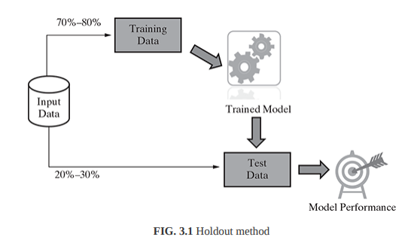
Holdout Method

Slide 8
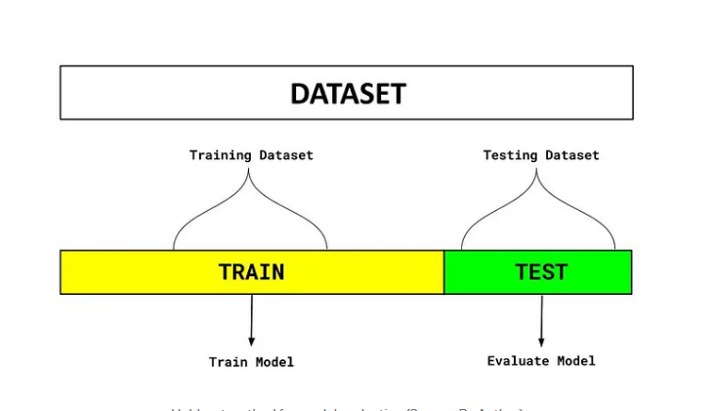
Holdout Method

Slide 9
Holdout Method
There are two parts to the dataset in the diagram above. One split is held aside as a training set. Another set is held back for testing or evaluation of the model.
The percentage of the split is determined based on the amount of training data available. A typical split of 70–30% is used in which 70% of the dataset is used for training and 30% is used for testing the model.
The objective of this technique is to select the best model based on its accuracy on the testing dataset and compare it with other models.

Slide 10
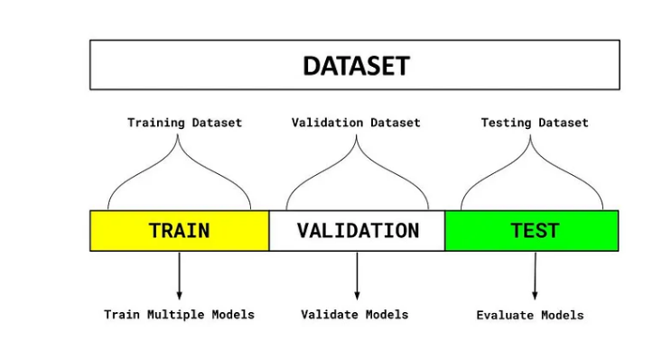
Holdout Method-train,vaildation,test

Slide 11
Holdout Method-train,vaildation,test
Train Dataset
Set of data used for learning (by the model), that is, to fit the parameters to the machine learning model
Valid Dataset
Set of data used to provide an unbiased evaluation of a model fitted on the training dataset while tuning model hyperparameters.
Also play a role in other forms of model preparation, such as feature selection, threshold cut-off selection.

Slide 12
Holdout Method-train,vaildation,test
Test Dataset
Set of data used to provide an unbiased evaluation of a final model fitted on the training dataset.

Slide 13
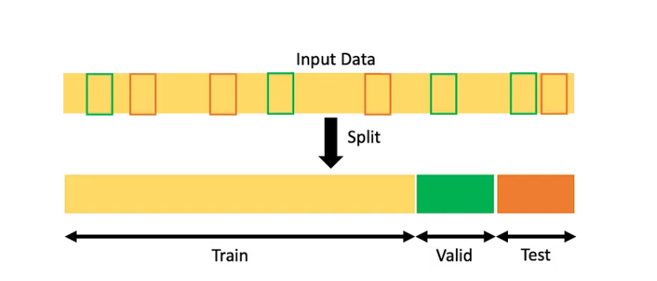
Holdout Method-train,vaildation,test

Slide 14
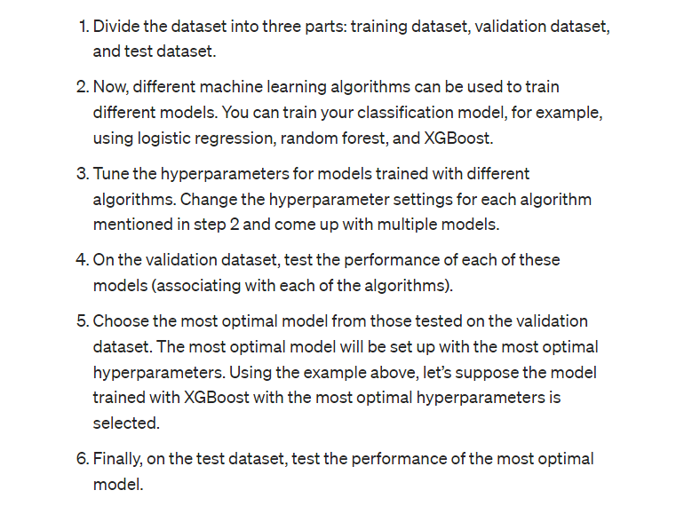
Holdout Method-train,vaildation,test

Slide 15
Holdout Method
sklearn.model_selection.train_test_split(*arrays, test_size=None, train_size=None, random_state=None, shuffle=True, stratify=None
from sklearn.model_selection import train_test_split
Link:
https://scikit-learn.org/stable/modules/generated/sklearn.model_selection.train_test_split.html
https://builtin.com/data-science/train-test-split

Slide 16
Python code
x_train, x_test, y_train, y_test = train_test_split( x, y, test_size=4, random_state=4 )

Slide 17
Python code
from fast_ml.model_development import train_valid_test_split
X_train, y_train, X_valid, y_valid, X_test, y_test = train_valid_test_split(df, target = target, train_size=0.8, valid_size=0.1, test_size=0.1) # Get the shape of all the datasets print(X_train.shape), print(y_train.shape) print(X_valid.shape), print(y_valid.shape) print(X_test.shape), print(y_test.shape)

Slide 18
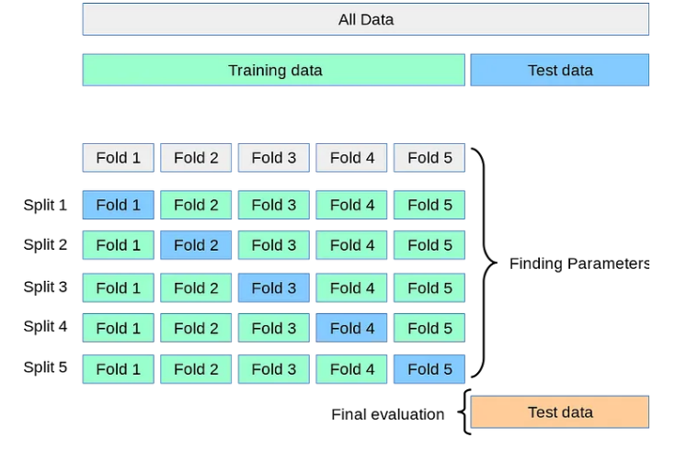
K Fold Cross Validation

Slide 19
. In k-fold cross-validation, the data set is divided into k-completely distinct or non-overlapping random partitions called folds. Figure 3.2 depicts an overall approach for k-fold cross-validation.

Slide 20
The value of ‘k’ in k-fold cross-validation can be set to any number. However, there are two approaches which are extremely popular:
1. 10-fold cross-validation (10-fold CV) 2. Leave-one-out cross-validation (LOOCV) 10-fold cross-validation is by far the most popular approach.

Slide 21
In this approach, for each of the 10-folds, each comprising of approximately 10% of the data, one of the folds is used as the test data for validating model performance trained based on the remaining 9 folds (or 90% of the data). This is repeated 10 times, once for each of the 10 folds being used as the test data and the remaining folds as the training data.The average performance across all folds is being reported. F

Slide 22
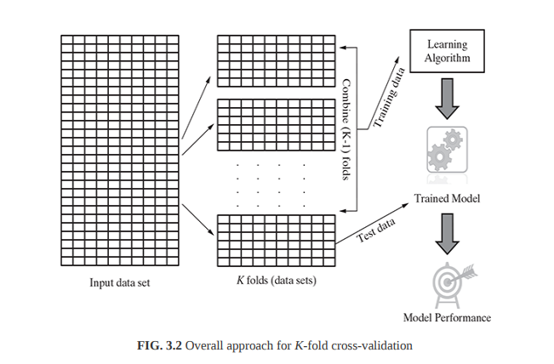

Slide 23
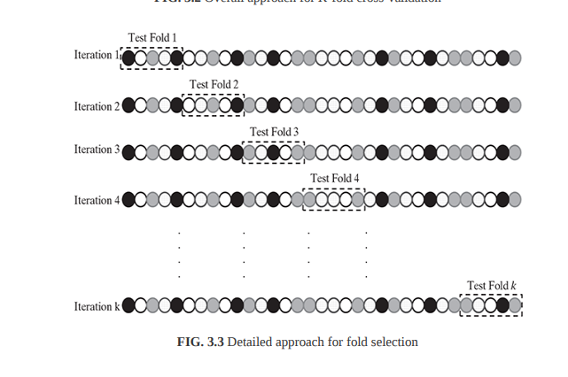

Slide 24
K Fold Cross Validation
https://isheunesu48.medium.com/cross-validation-using-k-fold-with-scikit-learn-cfc44bf1ce6

